Slide 1
Public Sentiment Toward the NFL Can it predict weekly Fantasy Football outcomes?
Ryan Timbrook
Diego Vales
David Madsen

Slide 2


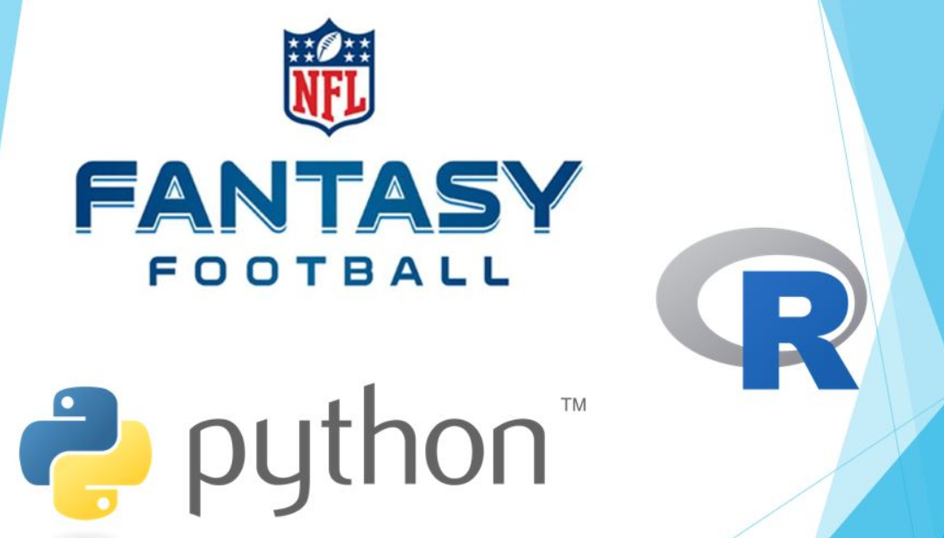
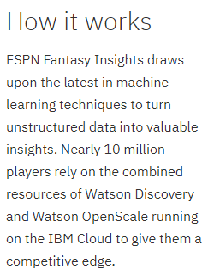

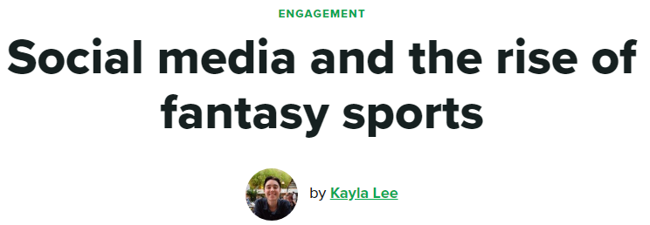

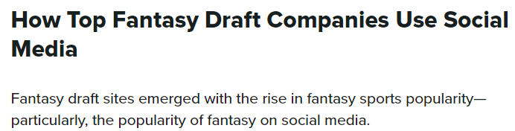



Data Science to help you win…

Slide 3
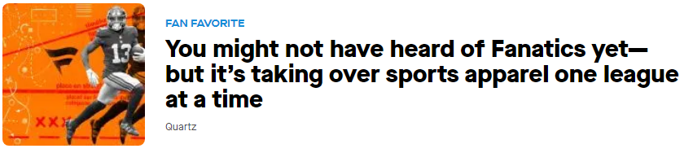
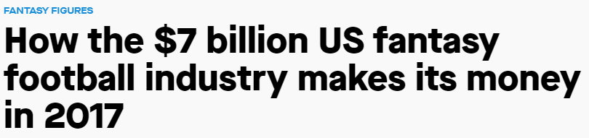
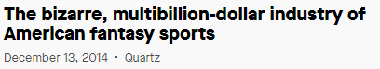
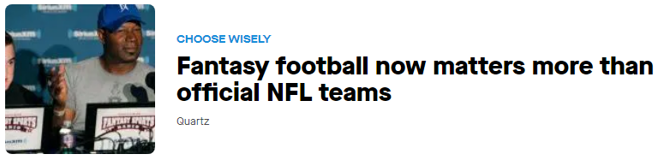
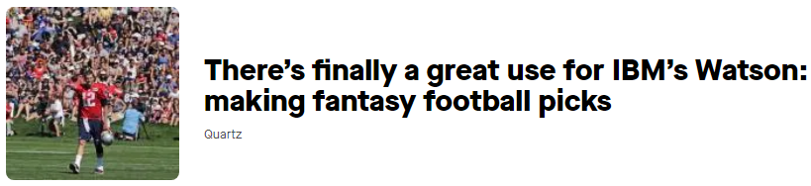
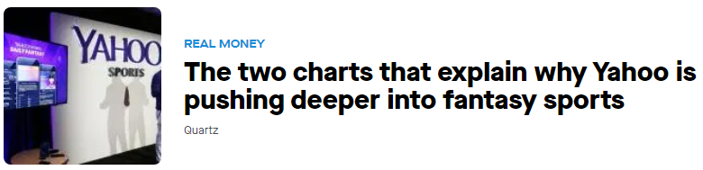
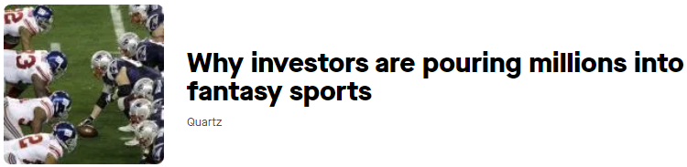
Media Headlines

Slide 4
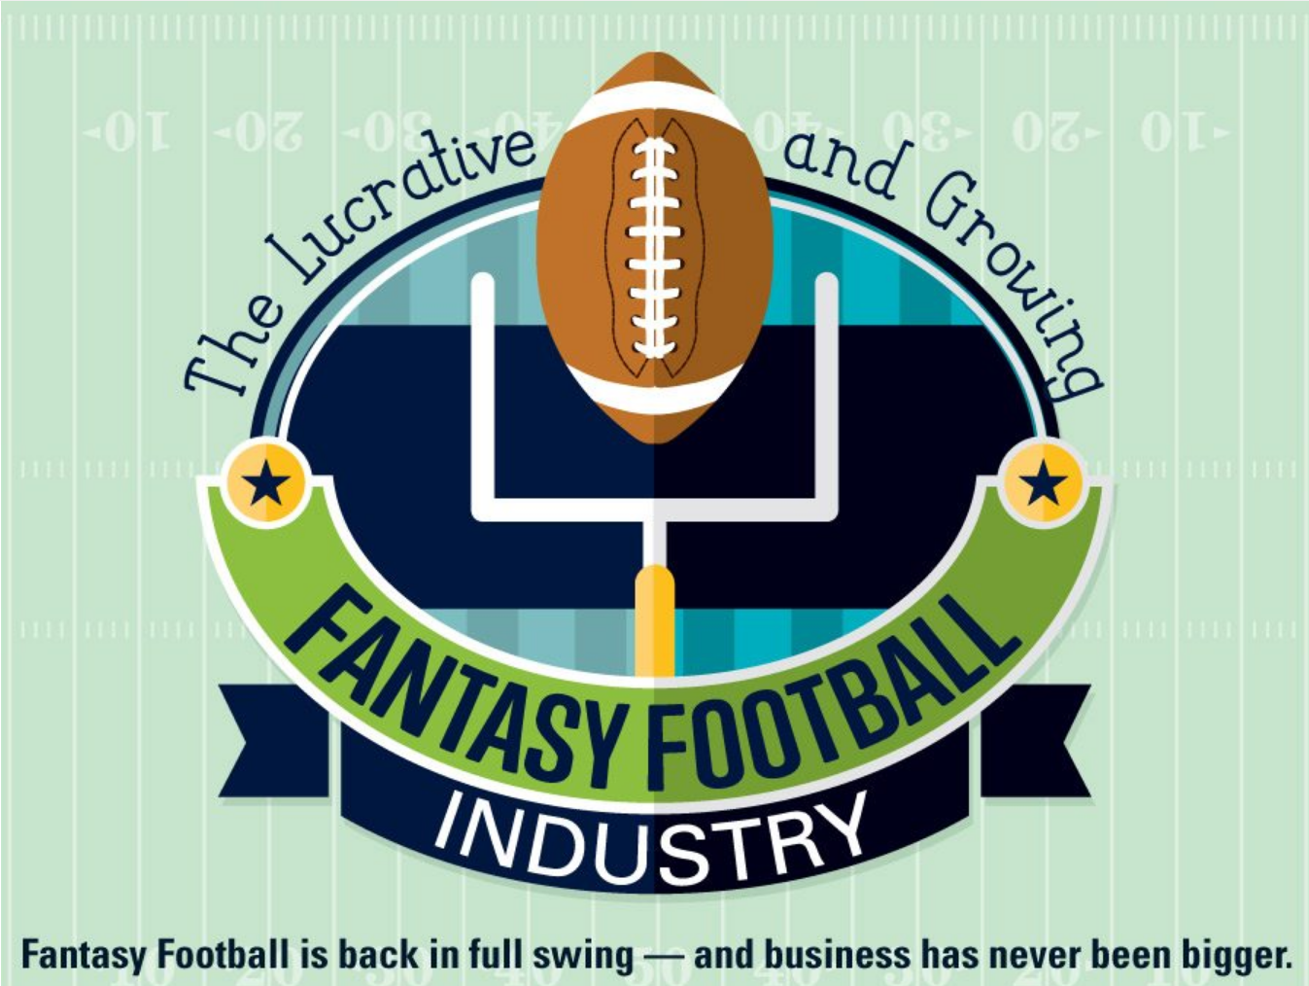
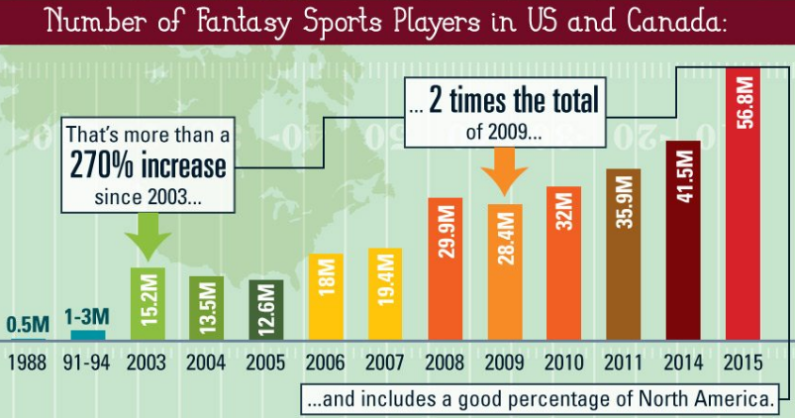
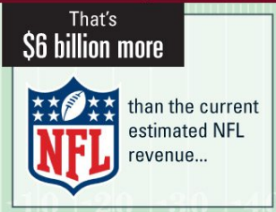
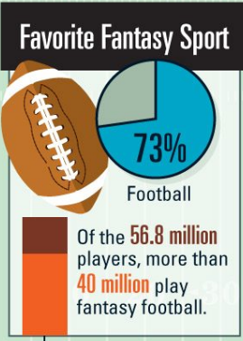
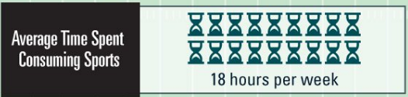
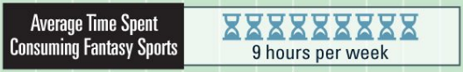

Fantasy Football Industry

Slide 5

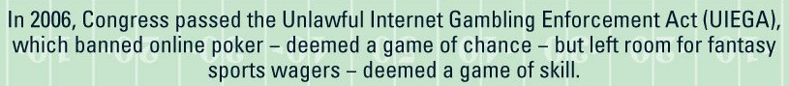
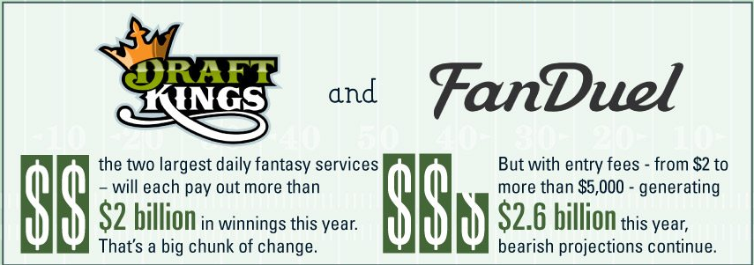
Fantasy Football Industry

Slide 6












Notable Fantasy Football Brands

Slide 7

Question and Problem to Solve
Business Driver
NFL revenue grew an estimated $900 million to $14 billion in 2017, in 2018 it generated about $15 billion.
Fantasy football and the spread of legalized sports betting across the U.S. promises to lock in fans and keep them focused on the game.
As a Fantasy football player, how can Data Science help me make the most intelligence selections when deciding my weekly roster? “How do I win more?”
Problem to Solve
Identify if real-time public popular opinion on NFL teams, players, and coaches is a predictor of their weekly fantasy football stats.
About the Data:
Text data will be mined from three primary sources
Fantasy football websites like Yahoo Sports: https://sports.yahoo.com/fantasy/
Twitter Social Media API streams
Facebook Social Media API streams

Slide 8
Questions?

